Slide 1
Discrete Mathematics (CSC 1204)
Chapter 2 2.1 Sets

Slide 2
Sets
Curly brace notation “{ … }”
Cardinality “| … |”
Element containment ∈
Subset containment ⊆
Empty set { } = ∅
Power set P(S ) = 2^{S}
N-tuples “( … )” and Cartesian product ×

Slide 3
Sets
Definition1: A set is an unordered collection of objects.
Definition2: Objects in a set are called elements, or members of the set.
A Set is said to contain its elements.
Capital letters (e.g. A, B, C, O, N) are ordinarily used to denote sets and lowercase letters (e.g., a, b, c, p) are used to denote elements of a sets.
Elements of a Set may NOT be the same type always!

Slide 4
Sets
A set is defined only by the elements which it contains. Thus repeating an element, or changing the ordering of elements in the description of the set, does NOT change the set itself.
Sets can have other sets as member.

Slide 5
Representation of a Set
Basically there are two ways of representing a set:
List/Tabular form: All elements of the set are listed, the elements being separated by commas(,) and are enclosed by curly braces “{“ and “}”
Example: B = { a, e, i, o, u}
A = { 2, 4, 6, 8}
Rule method, or Set builder form: A set is defined by specifying a property that elements of the set have in common.
Example: B = { x| x is a vowel in the English alphabets}
A = { x| x is an even integer between 1 and 8}

Slide 6
Different Types of Sets
Empty set/ Null set: A set with no member is called empty/null set. Empty set is denoted by ∅. Empty set is also denoted by { }
Examples: B = { }, A = { x is a multiple of 4 | x is odd }
Note: ∅ ≠ {∅}
Singleton set: A set with one element is called a singleton set. Examples: B = {4} , S = {a}
Finite set : A set with finite number of elements in it, is called a finite set. Example: A = { 1, 3, 4,77}
Infinite set : An infinite set is a set which contains infinite number of elements.
Examples: N = { 0, 1, 2, 3, ……….}
B = { 1, 1/3, 1/9, 1/27, ………..}

Slide 7
Some Examples of Sets
{1, 2, 3} is the set containing elements “1” and “2” and “3.”
{1, 1, 2, 3, 3} = {1, 2, 3} since repetition is irrelevant.
{1, 2, 3} = {3, 2, 1} since sets are unordered (order of elements does NOT matter)
{0,1, 2, 3, …} is a way we denote an infinite set (in this case, the natural numbers).
∅ = {} is the empty set, or the set containing no elements.
A = { a, 2, Fred, New York } ==> Although elements are usually same type, but they may be of different types

Slide 8
Sets: More examples
Example 1 : The set V of all vowels in the English alphabet cab be written as V = { a, e, i, o, u }
Example 2: The set O of odd positive integers less than 10 can be denoted by { 1, 3, 5, 7, 9 }
Example 4 : The set of positive integers less than 100 can be denoted by { 1, 2, 3, ………..,99 }

Slide 9
Standard Numerical Sets
N = {0, 1, 2, 3, …}, natural numbers
Z = {…,-2, -1, 0, 1, 2, …}, integers
Z⁺ = {1, 2, 3, …}, positive integers
Q = {p/q|p∈Z, q∈Z, and q≠0}, rational numbers
Q⁺ = {x∈R|x=p/q, for positive integers p and q}
R = real numbers
The real numbers: R ==> contains any decimal number of arbitrary precision
The rational numbers: Q ==> these are decimal numbers whose decimal expansion repeats

Slide 10
∈-Notation
The Greek letter “∈” (epsilon) is used to denote that an object is an element of a set. When crossed out “∉” denotes that the object is not an element.”
Example: 3 ∈ S reads: “3 is an element of the set S ”.
3 ∉ S reads: “3 is an not element of the set S ”.
Q: Which of the following are true:
3 ∈ R
-3 ∈ N
-3 ∈ R
0 ∉ Z⁺
∃ x, x∈R ∧ x² = - 5

Slide 11
∈-Notation
Answers:
3 ∈ R. True: 3 is a real number.
−3 ∈ N. False: natural numbers don’t contain negatives.
−3 ∈ R. True: −3 is a real number.
0 ∉ Z⁺. True: 0 is NOT a positive integer.
∃x x∈R ∧ x² = −5 . False: square of a real number is non-negative, so can’t be −5.

Slide 12
Venn diagram
Sets can be represented graphically using Venn diagrams.
In Venn diagrams, the universal set U, which contains all the objects under consideration, is represented by a rectangle. Note: the universal set varies depending on which objects are of interest
Inside the rectangle,
Circles or other geometrical figures are used to represent sets.
Sometimes points are used to represent the particular elements of the set.
Venn diagrams are often used to indicate the relationships between sets.

Slide 13
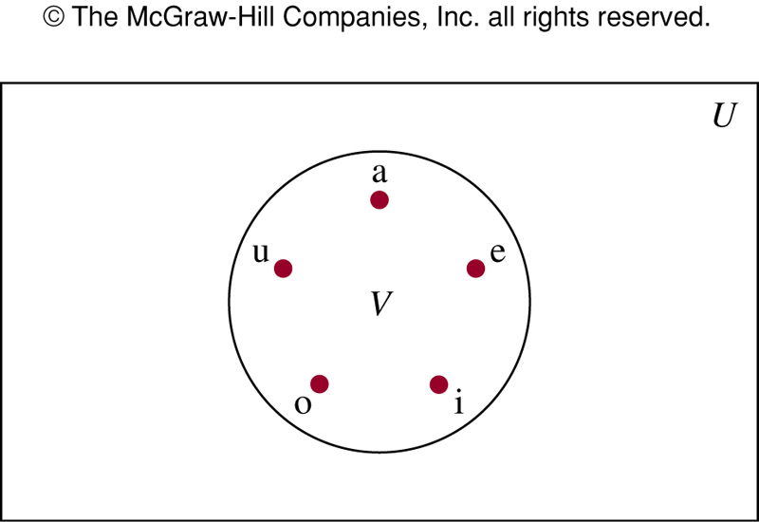
FIGURE 1 Venn Diagram for the Set of Vowels

Slide 14
Equal Set
Definition 3: Two sets are equal if and only if they have the same elements.
A = B iff ∀x(x ∈ A ↔ x ∈ B)
Two sets A and B are said to be equal if and only if every element of A is an element of B and consequently every element of B is an element of A; that is A ⊆ B and B ⊆ A and it is written as A = B
Example 6 (p.113) : The sets { 1, 3, 5} & { 3, 5, 1 } are equal because they have the same elements.

Slide 15
Subset
Definition 4: The set A is a subset of B if and only if every element of A is also an element of B.
We use the notation A ⊆ B to indicate that A is a subset of the set B.
A ⊆ B if and only if the quantification
∀x(x ∈ A → x ∈ B) is true
Note: Every non-empty set S is guaranteed to have at least two subsets, the empty set and the set S itself, that is ∅ ⊆ S and S ⊆ S

Slide 16
Subset
Theorem 1: For every non-empty set S,
(1) ∅ ⊆ S, and
(2) S ⊆ S
Note: If A⊆B and B⊆A, then A=B
Sets may have other sets as members
A = {∅, {a}, {b}, { a, b} }
B = { x | x is a subset of the set {a ,b } }
Note: These two sets are equal, that is, A = B
Note : In the above example, {a} ∈ A but a ∉ A

Slide 17
Proper Subset
Proper subset: Any subset A is said to be proper subset of another set B if A is a subset of B, but there is at least one element of B which does not belong to A, i.e.,
if A⊆B but A ≠ B
∀x(x ∈ A → x ∈ B) ∧ ∃x(x ∈ B ∧ x ∉ A)
A ⊂ B means “A is a proper subset of B.”
Example: A = { 1, 5 }, B = { 1, 5, 6}
Here, A is a proper subset of B, i.e., A ⊂ B

Slide 18
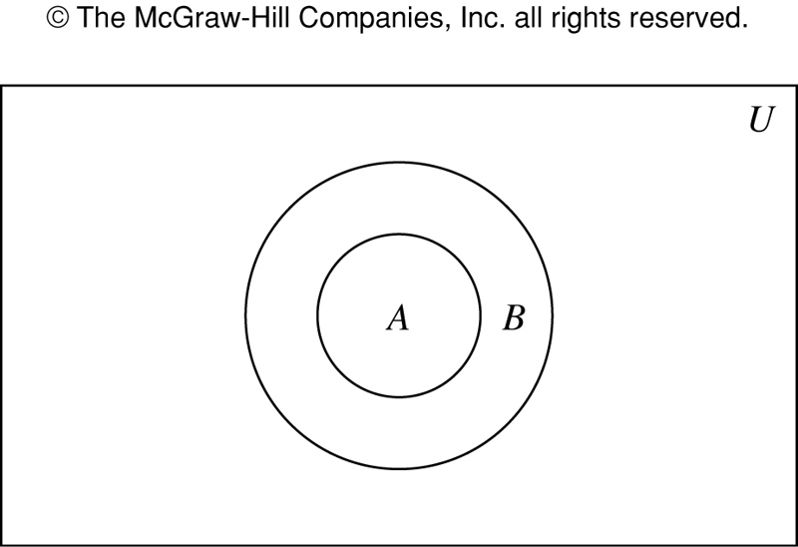
FIGURE 2 Venn Diagram Showing that A is a Subset of B

Slide 19
Cardinality of a Set
Definition: If there are exactly n distinct members in the set S (n is a nonnegative integer), we say that S is a finite set and that n is the cardinality of S.
The cardinality of a set is the number of distinct elements in the set.
|S | denotes the cardinality of set S.
Examples:
|S|= n
|∅|=0
| { 1, 5, 7, 8}|= 4

Slide 20
Cardinality of a Set
Question: Compute cardinality of each of the sets.
{1, -13, 4, -13, 1}
{3, {1,2,3,4}, ∅}
{}
{ {}, {{}}, {{{}}} }
Hint: After eliminating the repeatations/redundancies just look at the number of top level commas and add 1 (except for the empty set).

Slide 21
Cardinality of a Set
Answer:
|{1, -13, 4, -13, 1}| = |{1, -13, 4}| = 3
|{3, {1,2,3,4}, ∅}| = 3
|{}| = |∅| = 0
|{ {}, {{}}, {{{}}} }| = |{ ∅, {∅}, {{∅}}| = 3

Slide 22
Cardinality of a Set: More examples
Example 9 : Let A be the set of odd positive integers less than 10. Then |A| = 5
Example 10 : Let A be the set of letters in the English alphabet. Then |A| = 26
Example 11 : Because null set has no elements, it follows that, |∅| = 0
Example : The cardinality of the set {∅} is 1, i.e., | {∅} | = 1

Slide 23
Cardinality of a Set: More examples
If S = {1,2,3},
If S = {3,3,3,3,3},
If S = { ∅, {∅}, {∅,{∅}} },
If S = {0,1,2,3,…}, |S| is infinite.
|S| = 3
|S| = 1
|S| = 3.

Slide 24
Super Set
If A is a subset of B, then B is called the super set of A and written as B ⊇ A which is read as “B is a super set of A”.
A ⊇ V means “A is a superset of V.”
Example: { 1, 4, 7, 8} is a superset of the set { 4, 7 }

Slide 25
Quiz
Quick examples:
{1,2,3} ⊆ {1,2,3,4,5} Yes/No?
{1,2,3} ⊂ {1,2,3,4,5} Yes/No?
Is ∅ ⊆ {1,2,3}? Yes!
Is ∅ ∈ {1,2,3}? No!
Is ∅ ⊆ {∅,1,2,3}? Yes!
Is ∅ ∈ {∅,1,2,3}? Yes!

Slide 26
Quiz
Is {x} ⊆ {x}?
Is {x} ∈ {x,{x}}?
Is {x} ⊆ {x,{x}}?
Is {x} ∈ {x}?
Yes
Yes
Yes
No

Slide 27
Power Set
Definition : The power set of S is the set of all subsets of the set S.
We say, “P(S) is the set of all subsets of S”
The power set of S is denoted by P(S)
Note: If a set has n elements, then its power set has 2^{n} elements.

Slide 28
Power Set: Examples
Example 13: What is the power set of the set {0,1,2 } ?
Solution: The power set P ( { 0, 1, 2 } ) is the set of all subsets of { 0, 1, 2 } . Hence,
P ( { 0, 1, 2 } ) = {∅, {0}, {1}, {2}, {0,1}, {0,2}, {1,2}, { 0,1,2}}
Example 14: What is the power set of empty set? What is the power set of the set {∅} ?
Solution:
P(∅) = {∅}
P( {∅} ) = { ∅, {∅} }

Slide 29
Ordered n-tuples
The order of elements in a collection is often important. Because sets are unordered, a different structure is needed to represent ordered collections. This is provided by ordered n-tuples.
Definition : Ordered n-tuple (a₁, a₂, …, a_{n}) is the ordered collection that has a_{i} as its ith element for i=1, 2, …, n.

Slide 30
Ordered n-tuples
Two ordered n-tuples are equal if and only if each corresponding pair of their elements is equal.
In other words, (a₁, a₂ , ….., a_{n}) = (b₁ , b₂ , …….., b_{n} )
if and only if a_{i =} b_{i} for i = 1, 2, ……, n
2-tuples are called ordered pairs. The ordered pairs (a, b) and (c, d) are equal if and only if a = c and b = d
Note: ( a, b) and ( b, a ) are not equal unless a = b

Slide 31



Ordered n-tuples
Notationally, n-tuples look like sets except that curly braces are replaced by parentheses:
( 11, 12 ) ==> A 2-tuple (aka ordered pair)
( , , ) ==> A 3-tuple
( , , , 11, Leo ) ==> A 5-tuple

Slide 32
Ordered n-tuples
As opposed to sets, repetition and ordering
do matter with n-tuples.
(11, 11, 11, 12, 13) ≠ ( 11, 12, 13 )

Slide 33
Cartesian Product of Sets
Definition : Let A and B be sets. The Cartesian product of A and B, denoted by A × B, is the set of all ordered pairs (a, b), where a ∈ A and b ∈ B.
A × B = {(a, b)| a ∈ A ∧ b ∈ B}

Slide 34
Cartesian Product of Sets: Example
Example 16: What is the Cartesian product of
A = { 1, 2 } and B = { a, b, c} ?
Solution:
A X B = { (1,a), (1,b), (1,c), (2,a), (2,b), (2,c) }
Note : A × B and B × A are not equal, unless A=∅ or B=∅ or A=B
Note: Cartesian product of more than two sets can be defined
Note: A subset R of the Cartesian product A X B is called a
Relation from the set A to the set B (Relation will be
covered in the final term)
Practice @ Home: Example 17

Slide 35
Cartesian Product of Sets: Example
Question: If A = {1,2}, B = {3,4}, C = {5,6,7}
what is A ×B ×C ?
Answer:
A ×B ×C = { (1,3,5), (1,3,6), (1,3,7),(1,4,5), (1,4,6), (1,4,7),
(2,3,5), (2,3,6), (2,3,7), (2,4,5), (2,4,6), (2,4,7) }
Note: |A ×B ×C | = |A|.|B|.|C| = 2.2.3 = 12
Practice @ Home: Example 18

Slide 36
Practice @ Home
Relevant odd-numbered Exercises from your book
Exercises: 1, 3, 5, 7, 9, 11, 13, 15, 17, 19, 23, 27, 29, 33, 35

